Slide 1
Project Approval
Project Title: Linguistic analysis of Indo-European Languages
Project Guide: Mr. Shreekanth M Prabhu
Project Team:
Roshan U [01FB15ECS246], Sanath Bhimsen [01FB15ECS260], Mukesh M Karanth[01FB15ECS361].

Slide 2
Problem Statement
The current model of the Indo-European languages is a predominant-tree like structure which implies that all languages developed strictly divergently with little frequency of borrowing.
This might be a biased model due to the limited considerations and the restricted visualisation of the languages.
We want to broaden the considerations by including possibilities of word transfers and mutual growth and come up with a better, more realistic network model of the Indo-European Languages.

Slide 3
Literature Survey

Slide 4
Indo-European languages
The Indo-European languages are a language family of several hundred related languages and dialects.
There are about 445 living Indo-European languages, according to the estimate by Ethnologue, with over two thirds (313) of them belonging to the Indo-Iranian branch. The most widely spoken Indo-European languages by native speakers are Hindustani (Hindi-Urdu), Spanish, English, Portuguese, Bengali, Punjabi, and Russian, each with over 100 million speakers, with German, French, Marathi, Italian, and Persian also having more than 50 million. Today, nearly 42% of the human population (3.2 billion) speaks an Indo-European language as a first language, by far the highest of any language family.

Slide 5
Background
Indo-European Languages developed from Proto Indo European language which was spoken about 6500 years ago.
Domestication of horses and agriculture were one of the key reasons which led to the migration of people from Europe to India and other countries thus leading to birth of languages which share a connection which each other.

Slide 6
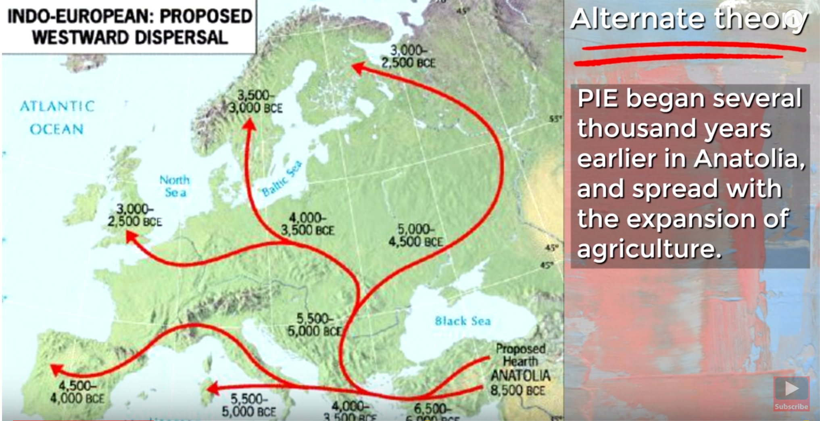

Slide 7
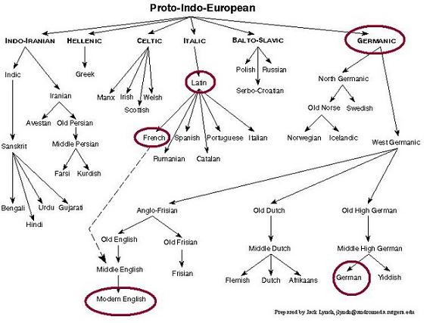

Slide 8
Motivation
Now that we have an idea that indo-european languages share a connection, we intend to analyze the similarities betweens words of different Indo-European languages and see the degree to which they cognate by modeling the languages.
When modeling the languages, everyone assumes that the evolution of languages is strictly divergent and the frequency of borrowing is very low and or non-existent.

Slide 9
As consequence, the results suggest a predominantly tree- like pattern of the Indo-European language evolution.
Hence, we want to model the Indo-European Languages as a network, using centrality measures and apply methods to estimate how close a language is to another language.

Slide 10
Sample Dataset

Slide 11
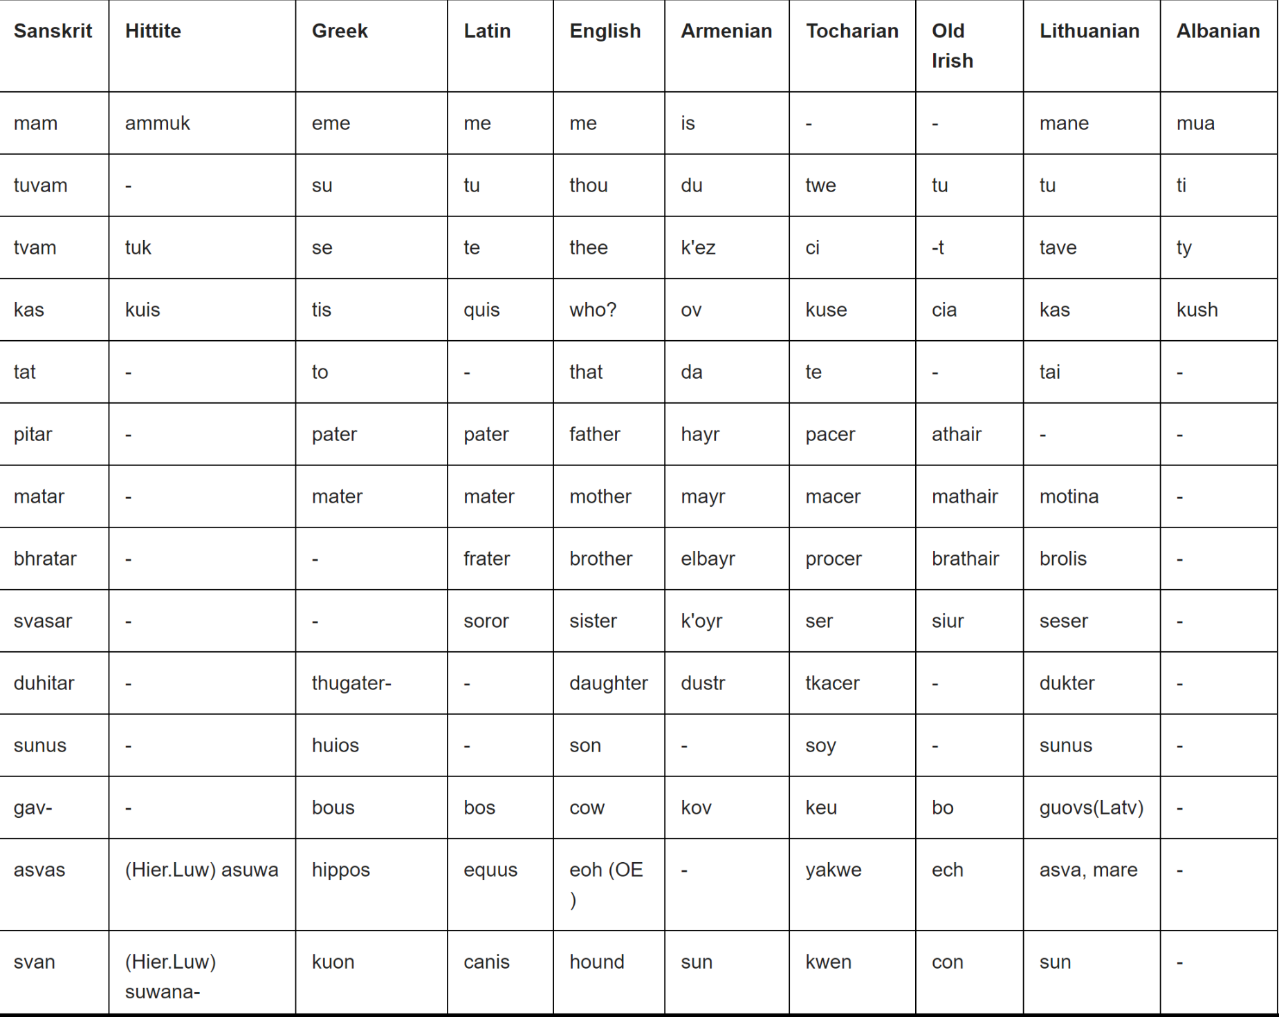

Slide 12
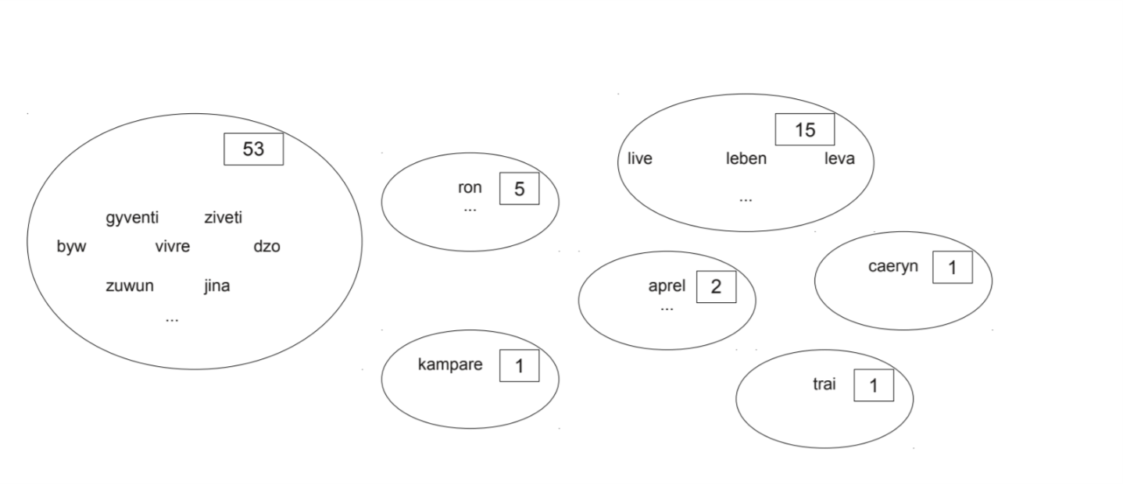
Cognate Clusters for the Word ‘Live’

Slide 13
Word similarity features(We intend to Consider to find cognates)
• Minimum edit distance
• The longest common prefix length
• Number of common bigrams
• The length of each word (2 separate features)
• The difference in length between the longer and the shorter word

Slide 14
Proposed Solution
Collect the dataset of Indo-European languages from Langfocus website and other similar websites.
Select a few key languages and preprocess the dataset for any discrepancies.
Perform analysis on the dataset, by getting distance between languages by the closeness of their words using distance measures like Levenshtein distance, etc. and centrality measures.
Understand and apply Horizontal Gene Transfer Detection Algorithm.
Combine all the results and visualise the dataset to obtain a new and better model of the layout of Indo-European Languages.

Slide 15
Why our solution is better?
It models the Indo-European languages in their true, unbiased states.
The result is not a predominant tree like structure which is purely divergent.
We get a complex network view of the languages with links to other languages due to word transfers which were previously disregarded.
Overall improvement of the understanding of how the Indo-European languages came to be.

Slide 16
Tools to be Used (Considerations)
iGraph tool in R:
Has good methods and features to perform network analysis and measures with ease.
Has a good visualisation functionality.
Language is user friendly.
Familiarity with the language and tool.

Slide 17
Project Timelines
Week 1 - Week 3:
Idea generation and approval from guide.
Understanding of the problem and development of problem statement.
Feasibility Study and Discussion with guide.
Week 4:
Discussion of the tools and technologies to be used.
Data Collection.
Week 5 - Week 7:
Development of the model and testing.
Fine Tuning the model and visualisations.
Week 8:
Optimisation.

Slide 18
Expected Contributions
Literature survey: Mukesh M Karanth, Sanath Bhimsen.
Data collection and preprocessing: Roshan U.
Data modeling via similarity measures: Sanath Bhimsen.
Data visualisation: Mukesh M Karanth.
Testing & verifying results: Roshan U.
Optimisations: Sanath Bhimsen, Mukesh M Karanth.
Documentation: Sanath, Mukesh & Roshan.

Slide 19
References
Boc A, Di Sciullo AM, Makarenkov V. Classification of the Indo-European languages using a phylogenetic network approach. In: Locarek-Junge H, Weihs C, editors. Classification as a Tool for Research. Berlin Heidelberg: Springer; 2010. p. 647–55.
Shreekanth M Prabhu, Evolving a Framework to interpret the Vedas.
Clustering Semantically Equivalent Words into Cognate Sets in Multilingual Lists http://www.aclweb.org/anthology/I11-1097

Slide 20
Thank You

